Slide 1
As a… | I want to…
New user | Be able to make a new account
Returning user (logged out) | Be able to login to my account
Returning user (logged in) | Be able to log out of my account
Returning user (logged in) | See the list of the restaurants I have visited
Returning user (logged in) | See the list of other restaurants in the Chicago area
Returning user (logged in) | Add dishes I liked to the restaurants I have visited
Returning user (logged in) | Look at dishes that others have submitted to restaurants I haven't visited
First time user / returning user (logged in) | Classify whether they have visited the listed restaurants

Slide 2
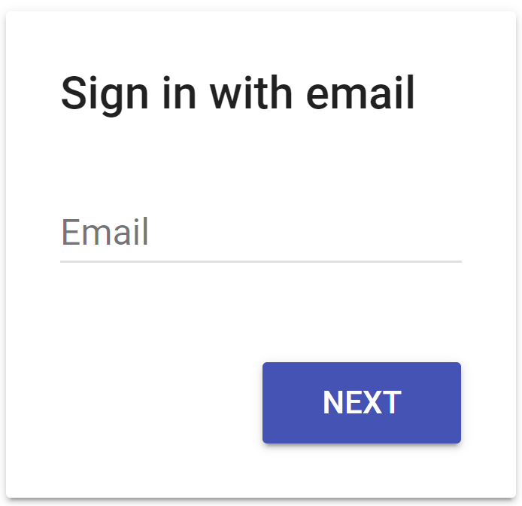
Welcome to Foodie Feed

Slide 3
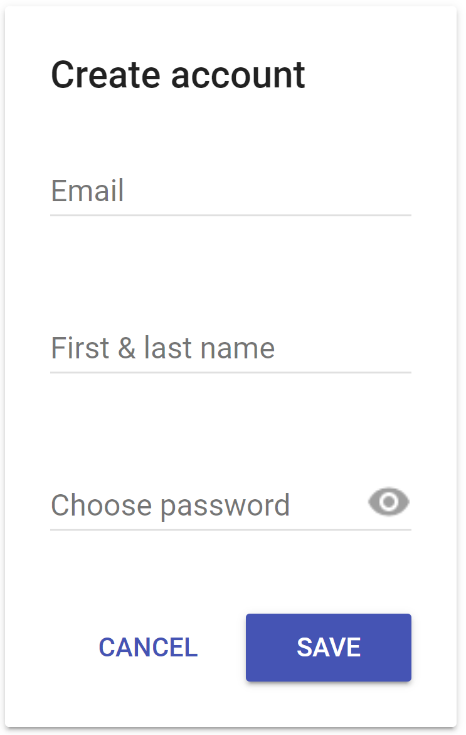
Welcome to Foodie Feed

Slide 4
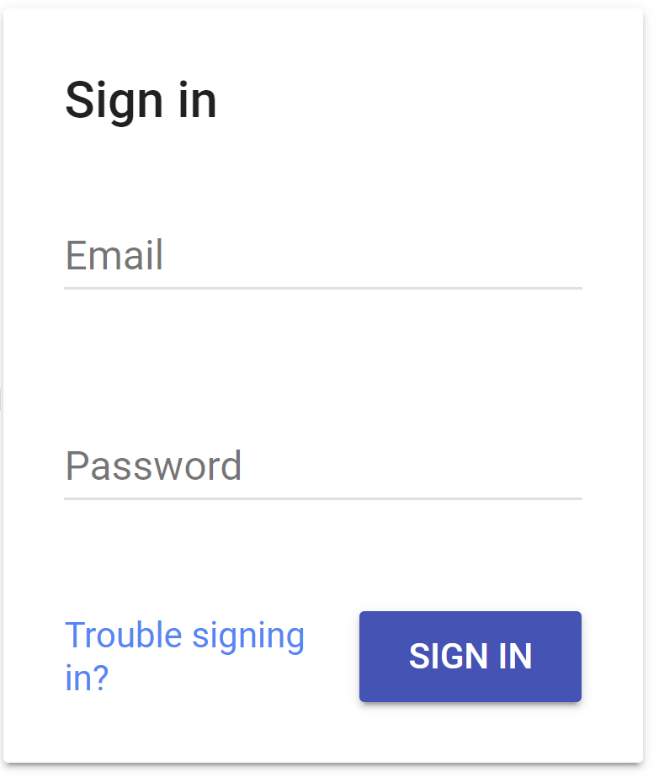
Welcome to Foodie Feed

Slide 5
Foodie Feed
My Restaurants
Sign Out
Explore Chicago Restaurants
Restaurant Pic
Restaurant Pic
Restaurant Pic
Restaurant Name
Neighborhood
Cuisine Star Rating
Restaurant Name
Neighborhood
Cuisine Star Rating
Restaurant Name
Neighborhood
Cuisine Star Rating
Mark as Visited
Mark as Visited
Mark as Visited

Slide 6
Foodie Feed
Restaurant Feed
Sign Out
My Visited Restaurants
Restaurant Pic
Restaurant Pic
Restaurant Pic
Restaurant Name
Neighborhood
Cuisine Star Rating
Favorite Dishes
Dish #1
Dish #2
Dish #3
Restaurant Name
Neighborhood
Cuisine Star Rating
Favorite Dishes
Dish #1
Dish #2
Dish #3
Restaurant Name
Neighborhood
Cuisine Star Rating
Favorite Dishes
Dish #1
Dish #2
Dish #3
+
+
+

